Slide 1
Using the MLA Format to Cite Common Sources
English Mini Lesson
Ms. Katie Schultz

Slide 2
Why do we need to cite our sources?
To give credit to the author or source of your data
To prove that your research is current and relevant
To provide more sources for your reader to explore
Notes:
To give credit to the author or source of your data
To prove that your research is current and relevant
To give your reader more sources they might look for to find more information about your topic.

Slide 3


Commonly Used Sources for Research Papers
Books
Article on a website
Article in an online journal
Survey or interview (evidence you collect)

Slide 4
General Guidelines for Works Cited Pages
Reverse indent (The first line is not indented, but the rest are)
Authors names are typically listed last name, first name.
Be very careful with punctuation – follow the guidelines exactly.
Dates are written in day month year format (11 November 2012)
If no author is listed, just start with the next element.

Slide 5
*In-text Citations – General Guidelines
At the end of your quote or sentence of reference:
  In parenthesis, give the author’s name and the page number, if possible. If the author’s name is not available, give the title.
  Example:
  Wordsworth stated that Romantic poetry was marked by a "spontaneous overflow of powerful feelings" (263).
  Romantic poetry is characterized by the "spontaneous overflow of powerful feelings" (Wordsworth 263).

Slide 6

Citing Books with one or Two Authors
Book with one author:
Pfeffer, Susan Beth. Life As We Knew It. Orlando:
Harcourt, 2006. Print.
Book with two authors:
Dart, Iris Rainer and Joyce Brotman.
Larry, the King of Rock and Roll. New York:
Putnam, 2007. Print.
Lastname, Firstname. Title of Book. City of Publication:
Publisher, Year of Publication. Medium of Publication.

Slide 7
Citing Electronic Sources
Article on a Website:
"Guinea Pigs." National Geographic Encyclopedia. 16 January 2009.
<http://nationalgeographicency/Guinea_pig>.
Citation for Articles from an Online Database
Cordell, Melinda R. "E.B. White and His Spiders." Highlights for Children. October
2008: 32. Infotrac. Downers Grove Public Library, Downers Grove, IL. 16 January
2009. http://find.galegroup.com
The author's name is listed, last name first, followed by the title of the article in quotation marks. Next is the title of the periodical, which is underlined, followed by the publication date, a colon, and the page numbers. Then list the name of the database, the institution providing the database, its location, the date you accessed the article, and the URL for the homepage of the service.

Slide 8
Citing Interviews
Personal interviews refer to those interviews that you conduct yourself. List the interview by the name of the interviewee. Include the descriptor “Personal interview” and the date of the interview.
Purdue, Pete. Personal interview.
1 December 2010.

Slide 9
Published Interviews (Print or Broadcast)
List the interview by the name of the interviewee. If the name of the interview is part of a larger work like a book, a television program, or a film series, place the title of the interview in quotation marks. Place the title of the larger work in italics. If the interview appears as an independent title, italicize it. Determine the medium of publication (e.g., print, Web, DVD).
Jolie, Angelina. "Being a Mother." 60 Minutes. CBS. WCBS, New York:
3 February 2009. Television.

Slide 10

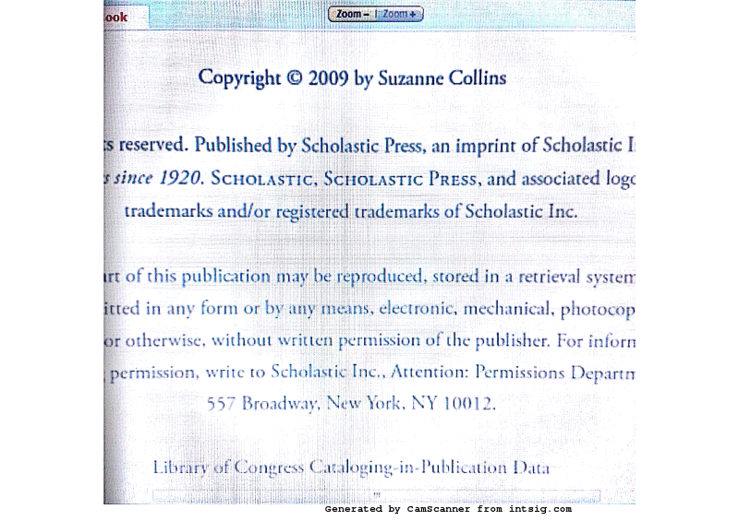
Practice Citing!

Slide 11
Where to go for more help or for guidance with unusual citations
Go to http://owl.english.purdue.edu/ and click on MLA Style Guide
There are some citation generators available to use online, but make sure you double check to make sure they are accurate!
Contact me.

Slide 12
Questions?

